Slide 1
Managing Dysregulated Youth Managing and Problem-Solving Through the Power of Relationship
Emily M. Jones, LCSW
January 23, 2024

Slide 2
agenda
INTRODUCTION 3
SETTING THE STAGE 4
LEVERAGING RELATIONSHIP 11
MANAGING CHALLENGING BEHAVIOR 15
QUESTIONS 13

Slide 3
introduction
Wife and Mom
Owner and Therapist at Creative Spirit Counseling
Educator for Minot State/NDSU Collaborative Program
10 Years of Experience Working with Adolescents and Children
All Levels of Care

Slide 4
Setting the Stage

Slide 5
Behavior Has Purpose
All Behavior Has Purpose (maladaptive and adaptive)
Illicit Sympathy
Regain Control
Needs Met
Assess Behavior in the Context of the Situation
Treat All Youth with Trauma-Responsive Care

Slide 6
Axioms of Working with Youth
Expect “Madness, Badness and No Easy Rides”
Adults MUST be “Stronger” and Healthier
Beware of Memory Contagion
Differentiate Between Style and Substance (choose your battles)
Youth are Similar yet Different
Notes:
No youth will ever be “good” all the time. This is not contingent on trauma or out of home placement.
It is incumbent upon us as adults to managing our own “stuff”. Adolescents have a unique ability to trigger unresolved conflict in ourselves.
We often romanticize our own childhoods and denigrate the younger generation.
Each generation has “hallmarks” of their style. Going to school is substance. What they wear is style. (within reason)

Slide 7
What is Trauma?
The unique individual experience of an event or enduring condition in which the individual’s ability to integrate his or her emotional experience is overwhelmed: and the individual experiences a threat to life, bodily integrity, or sanity.

Slide 8
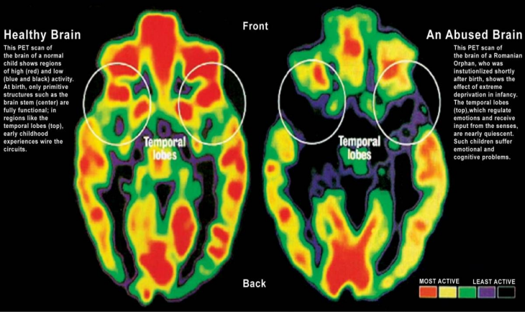

Slide 9
Trauma Impacts…
Relationship Building
Sensory Input
Emotional Regulation
Executive Functioning
Notes:
How can children safely attach when they have been removed from primary attachment figures?
Trauma impacts the BODY and BRAIN DEVELOPMENT thus impacting sensory integration.
Children are hardwired for getting needs met. Often maladaptive ways are modeled and children do not have the maturity to regulate on their own.
Children do not have fully formed brains. When trauma is involved, we think in our braid stem and not in our executive functioning.

Slide 10
Dr. Perry’s Sequence of Engagement
Establish REASON
CORTEX
Establish RELATION
LIMBIC
DIENCEPHALON
Establish REGULATION
BRAINSTEM

Slide 11
Leveraging Relationship

Slide 12
Why is Relationship Important?
TRAUMA
Results from failure of connection; Healing is built on RESTORATION
STRESS
Necessity for Managing Stress and Building RESILIENCE
SELF-REGULATION
To regulate we must first, CO-REGULATE
Healthy Therapeutic Relationships Predict LONG-TERM OUTCOMES
OUTCOMES

Slide 13
Relational Contagion
A dysregulated adult can never regulate a dysregulated youth.
A dysregulated adult can dysregulate a regulated youth.
A regulated adult can regulate a dysregulated youth.

Slide 14
Relational Damage
Results of Youth Mistrust of Adults
Adults Response to Mistrust
Self Soothers
Hypervigilance
Indiscriminant Attachment
Deception and Manipulation
Self-Preservation
Hiding and Lying
Avoiding Closeness
Competing
Caregiver in Survival Mode
Defensive
Apathy
Focus on Behavior not Meaning
Reactive not Responsive
Repeat Unproductive Actions
Correction not Connection
Rejection Sensitivity
Self-Entitlement

Slide 15
Managing Challenging Behavior

Slide 16
What is a challenging Behavior?
Challenging behavior (explosions, implosions, and everything in between) occurs when an expectation is placed on someone, or someone is presented with a situation in which they lack the skill to cope. It is the gap between demands and skills.

Slide 17
Punitive Punishment and Trauma Response Cycle
Increased Arousal/Stress Response
Skills Deficit/Unmet Needs
Challenging/Explosive Behavior
Consequence Focused/Harsh Discipline

Slide 18
Responding to Challenging Behavior
Regulator (Plan A) | Collaborator (Plan B) | Harmonizer (Plan C)
Imposition of Adult Will | Mutual Problem-Solving | Let It “Slide”
Focus: Adult Concern | Focus: Mutual Concern | Focus: Youth Needs
Use: Safety Concerns; Neurotypical Youth | Use: Collaborative Problem-Solving | Use: Meet Needs; Keep Peace; Restore Homeostasis
Potential Outcomes: Can impact stress response; safety maintained | Potential Outcomes: Balanced Stress Response; Mutual Regulation | Potential Outcomes: Minimal Stress Response; Missed Opportunity
Power Dynamic: Increases Adult-Youth Power Differential | Power Dynamic: Shared Power | Power Dynamic: Decreases Adult-Youth Power Differential
Appropriateness: Immediate Safety | Appropriateness: Most Challenging Behavior | Appropriateness: Low Stakes; Not Part of Treatment Plan

Slide 19
A Reflection
Youth asks to eat in their room away from Foster family
Youth had a disappointing phone call with Bio-Parent
Foster parent responds with “no”
Youth Escalates and begins throwing items and punching walls
Foster parents become dysregulated/law enforcement is called

Slide 20
A Reflection
Youth displays “snarky” attitude and provokes foster siblings
Youth had a great weekend visit with bio family
Foster parent responds with care and concern to foster youth
Youth engages in collaboration resulting in vulnerable conversation
Youth and Foster Family maintain Trust and Respect

Slide 21
A Reflection
Youth becomes verbally aggressive with foster family and siblings
Youth found out they will not be returning home to bio family
Foster parent allows behavior due to sympathy
youth withdraws from the family
Youth continues to berate and escalate when stress response is high

Slide 22
Aw man, I messed up…now what?
What are the safety concerns? Are you or anyone else in IMMINENT danger?
No- REGULATE, NO DISCOURSE
Yes- Call Mobile Crisis or Law Enforcement

Slide 23
Resources
Cooke Douglas, A. (2021, October 1). Meeting Children Where They Are: The Neurosequential Model of Therapeutics. Adoption Council. Retrieved January 23, 2024, from https://adoptioncouncil.org/wp-content/uploads/2021/09/Adoption-Advocate-No.-160.pdf
de Soet R, Nooteboom LA, Bansema CH, van Ewijk H, Nijland L, Vermeiren RRJM. How to meet the needs of youth with severe and enduring mental health problems: A qualitative study to barriers and facilitators in treatment. Children & Youth Services Review. 2023;155:N.PAG. doi:10.1016/j.childyouth.2023.107155
Minske, P., & Williams, E. (2022, March 1). Empowering Restorative Engagement [Power Point]. Association of Children's and Residential & Community Services. de Soet R, Nooteboom LA, Bansema CH, van Ewijk H, Nijland L, Vermeiren RRJM. How to meet the needs of youth with severe and enduring mental health problems: A qualitative study to barriers and facilitators in treatment. Children & Youth Services Review. 2023;155:N.PAG. doi:10.1016/j.childyouth.2023.107155
Perry, B., & Szalavitz, M. (2006). The Boy Who Was Raised As A Dog. Basic Books.
White SW, Conner CM, Beck KB, Mazefsky CA. Clinical Update: The Implementation of Evidence-Based Emotion Regulation Treatment for Clients with Autism. Evidence-Based Practice in Child & Adolescent Mental Health. 2021;6(1):1-10. doi:10.1080/23794925.2020.1796551

Slide 24
Book Recommendations
Teens Who Hurt- Kenneth Hardy and Tracey Laszloffy
The Boy Who Was Raised as a Dog- Bruce Perry and Maia Szalavitz
The Body Keeps the Score- Bessel van der Kolk
Treating Explosive Kids: The Collaborative Problem-Solving Approach- Ross Greene

Slide 25
Please Reach Out!
Emily M. Jones, LCSW
Emily@creativespiritcounseling.com
www.creativespiritcounseling.com

